Slide 1
Our goal is to reduce environmental waste and to research and experiment with recently discovered plastic eating worms and beetles. People should care because it will help make earth a cleaner and healthier environment by possibly providing a partial solution to the millions of tons of annually discarded plastic products.
This is also a broader concern because of the ocean plastic debris is contaminating and killing marine organisms, those that we eat and others that all comprise part of the marine ecosystem.

Slide 2
Our hypothesis is that while specific species of worms do eat forms of plastic, it might not provide a mass solution to plastic waste. We did prior research and discovered that mealworms and super-worms have been shown to eat styrofoam and plastic bags. We began our experiment with various species of worms placed in glass containers with styrofoam, films, PET, etc.. We had rapid results, pictures and data on weights of worms and remaining plastic pieces. Regardless of our experimental results, our project can highlight the importance of discovering technical, biological and scientific innovations to the problem. Through our outreach presentations to others we can emphasize the importance of re-use, recycling and alternatives to plastic use.

Slide 3
Materials
Glass jars
Screening
Wax worms
Mealworms
Tomato horn worm
Plastics: Styrofoam (PU & PS), Polyethylene HD & LD, PVC
Heating light

Slide 4
Procedure
First we will weigh the plastic. After about two weeks (or when the larvae transition to cocoons) we will weigh the plastic again to determine how much was eaten. We shall observe their life cycle and metamorphosis from larvae to moth (which lays eggs) again to larvae. Then, we’ll continue to feed them more plastic so they will not run out of their energy source and repeat the experiment with both the same plastic types and new. We will also see which ones die because they cannot digest the plastic, and which were able to metabolize the most.

Slide 5
Research & Background
Brief summary of research articles.
Mealworms and Wax worms are known to eat plastic
We will feed a variety of worms plastic and see which ones will eat it.
This will further the research by giving new types of plastics to the worms to see if they can eat it. Also by trying to breed the different worms, to repeat the experiment with possibly different results
Wax worm are typically used for fishing bait but known for damaging beehives by eating the wax comb.
Mealworms are used as pet food, fishing bait, or captive reptiles, fish and birds. Due to research and experimentation they are also known for eating styrofoam.
Tomato horn worms do not eat plastic they eat vegetation

Slide 6
Discussion
A critical environmental problem is that there are tens of millions of tons of discarded plastic waste that is polluting the oceans and land and causing ecosystem disruptions and reducing organisms survivability. What we are trying to do with the worms is to see if they can eat various types plastic (molecularly different polymers) and get release energy thru their digestive process, survive and reproduce. Our research demonstrated that wax and mealworms are able to consume only specific plastic types. Such as: XXXXXX
The tomato horn worm was not able to eat plastic. We tested them by first trying out plastics inside the jars. Once we saw they consumed no plastic we decided to breed them to perform more experiments. We failed. So from our experimentation we concluded that that wax and mealworms eat plastic.

Slide 7
You need data---weights of plastic, number of worms per jar...when you repeated the experiment what were your results. Same, different, same types of plastic and some were different?
Thios should be in the form of a chart---which you will also put ion your binder along with a copy of each PPT slide.
Make the slides colorful, find a cute worm to put on some slides.. You need pix of the hioles the worms made while eating the plastic.
Did you have a control? Meaning worms that had no plastic. How long were they in the larval stage? Shorter or longer than those that ate plastic. Did they suyrvive.

Slide 8
Problem
Plastic pollution is a problem that the whole world is facing. We thought of ways of fixing this problem and we believe that using worms was a possible but minimally effect way to remove plastic waste. But the number of worms needed...based on our experiment and research would be so astronomical as to make it not practical. There is also the danger of the wax moths being released and destroying bee hives, which are in a critical situation with Colony Collapse Disorder (CCD) already. YOU KEEP REPEATING THIS. IT IS ALL TOO GENERAL. YOU ARE YOUNG SCIENTISTS WRITING ABOUT RESEARCH--NOT A SHORT STORY. YOU NEED DATA!!!

Slide 9
Next Steps
Procedures and analysis that we could have improved upon:
Finding other breeds of worms that can eat plastic and survive the process.
Find other insects besides worms that can help eliminate plastic pollution.
Better pictures and more accurate data collection...more sensitive scale.
A logbook with more in-depth recording of numbers, worm weights, numbers of worms reproduced by category of plastic consumption...

Slide 10
Where our Interest has taken us
Realizing that wax worms are not the solution we thought and hoped they might be we decided to research new innovations being developed internationally.
We found and were inspired by many that include:
HERE IS WHERE YOU NEED A LIST FROM CITLALI/ADRIANA/MARLEN/ WHIO ARE DEVELOPING THESE ON A SEPARATE POSTERBOARD FOR YOU.

Slide 11
ALL PICTURES MUST BE LABELED...WHAT IS HAPPENING. HOW LONG DID THIS TAKE/ WHICH WAS MOST SUCCESSFUL/ HOW LONG WAS IT BEFORE THEY WENT INTO THE COCOON PHASE

Slide 12
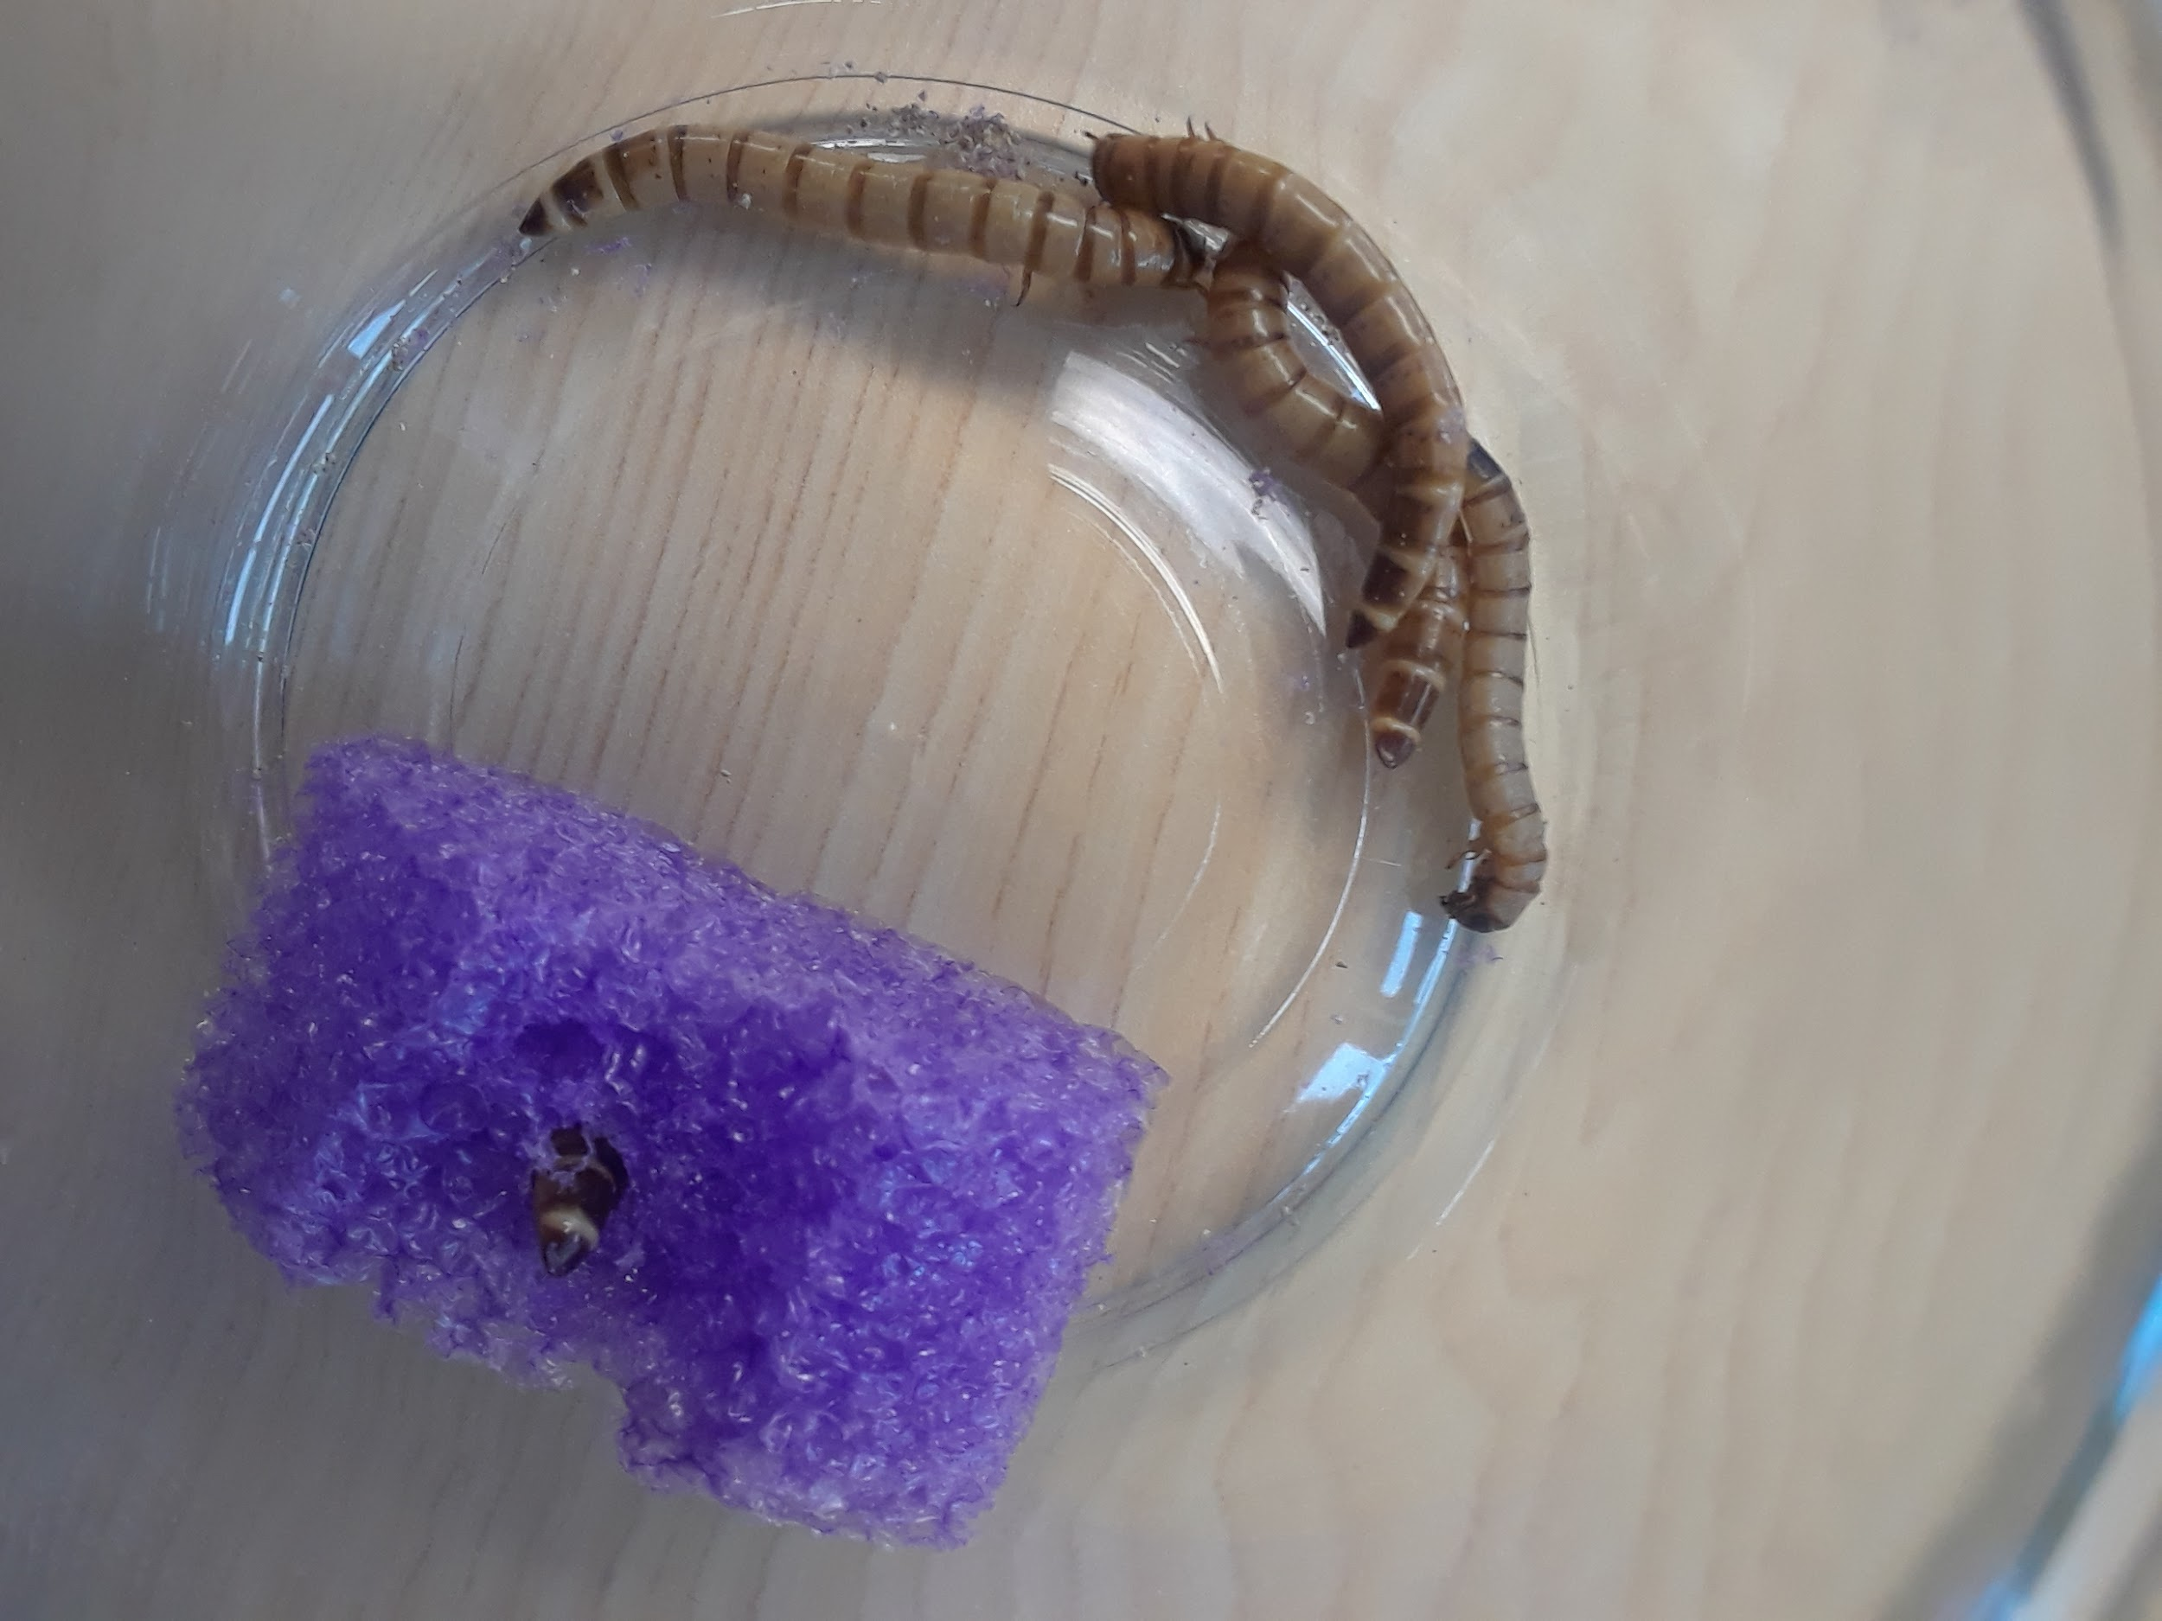

Slide 13
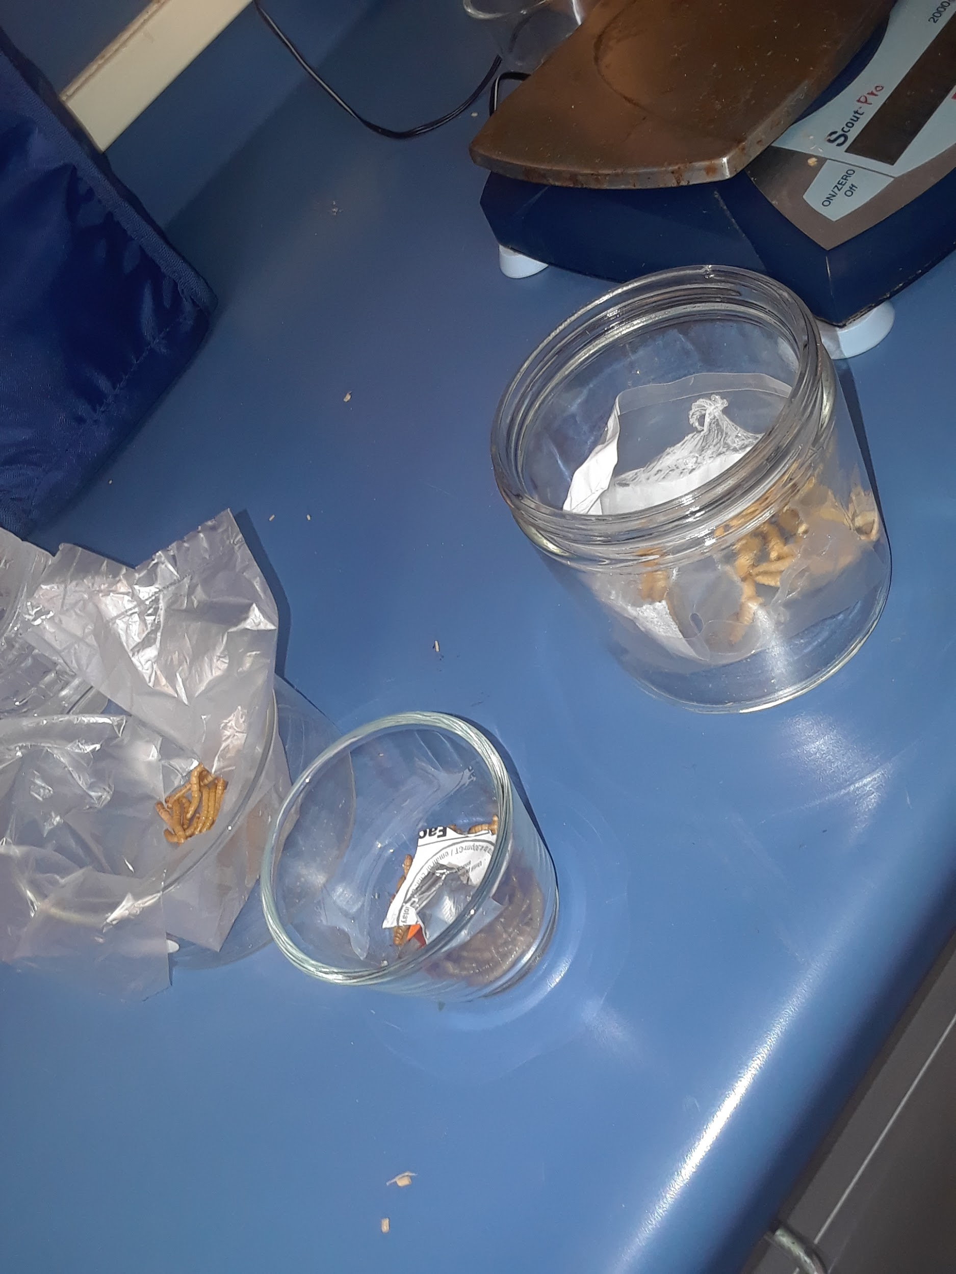

Slide 14
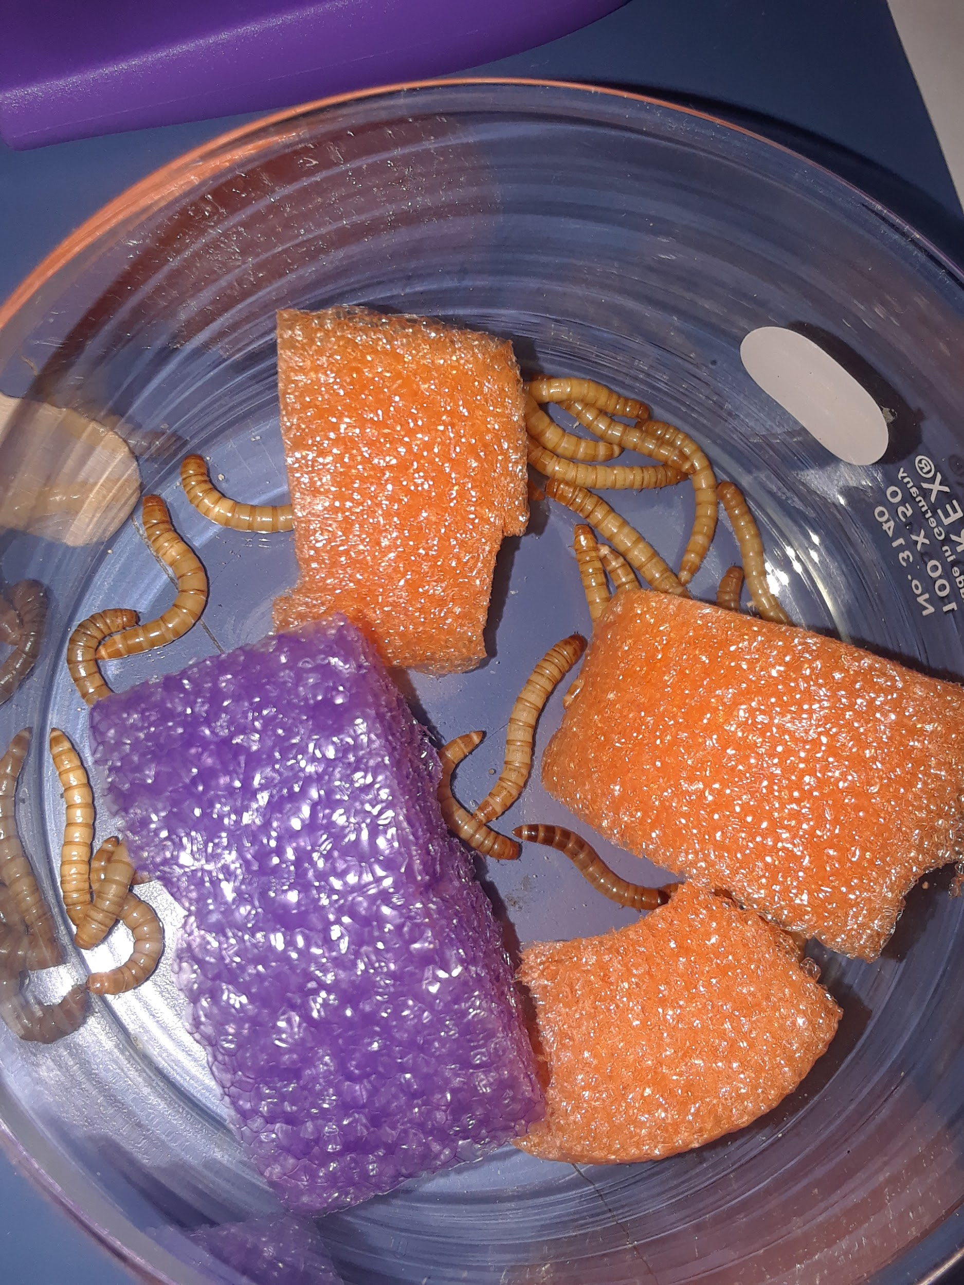

Slide 15
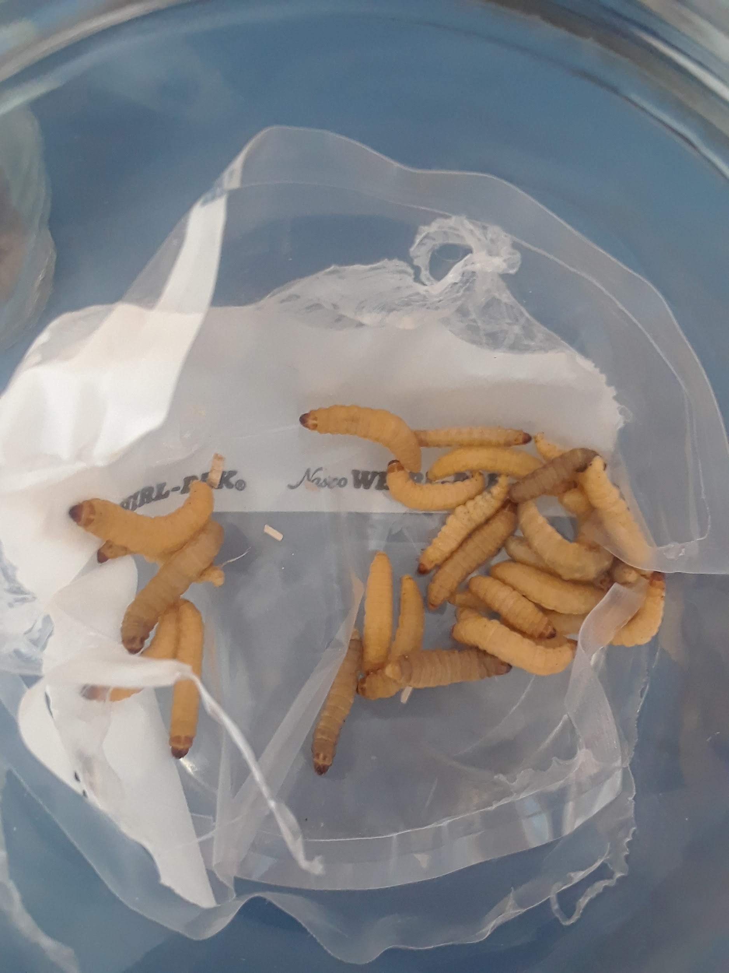

Slide 16
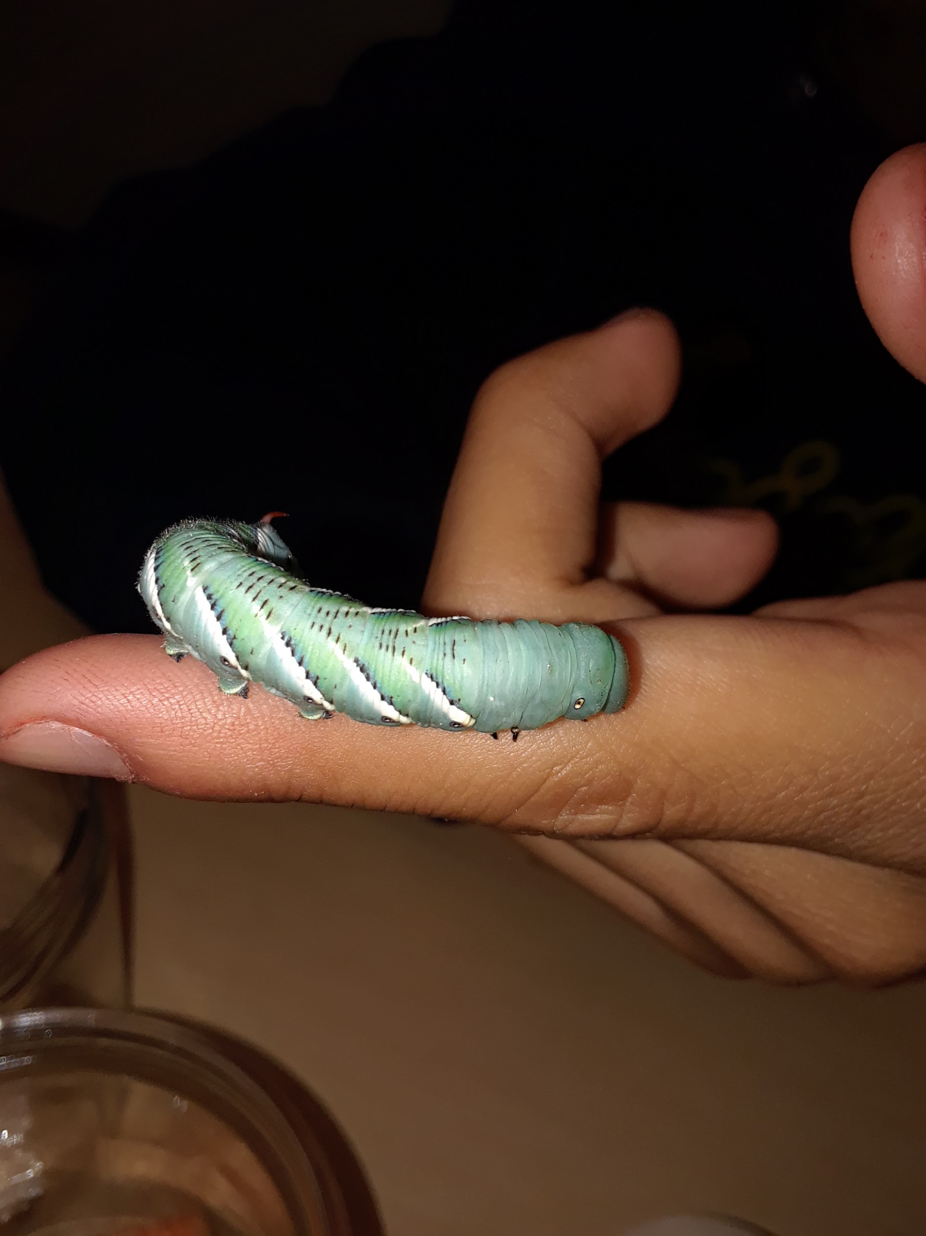

Slide 17
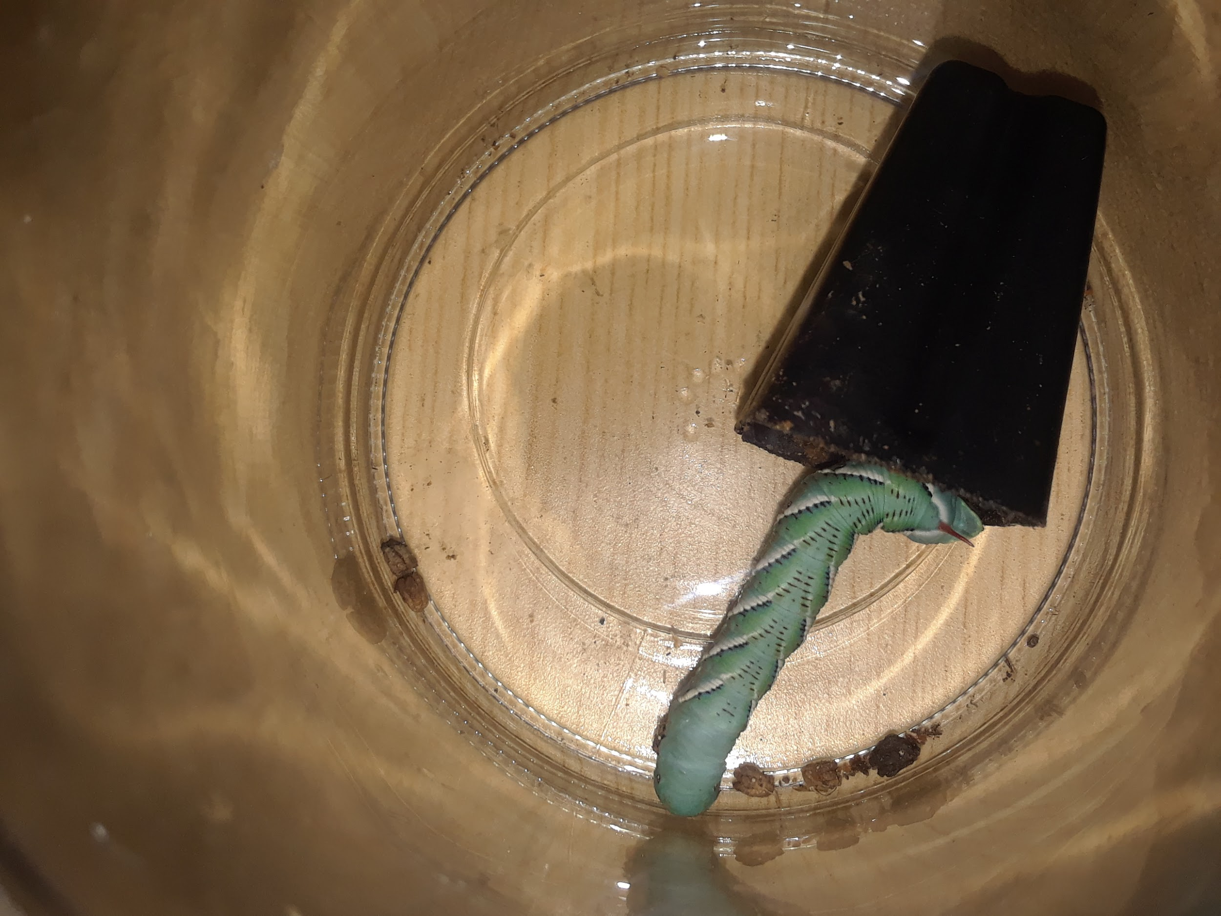

Slide 18
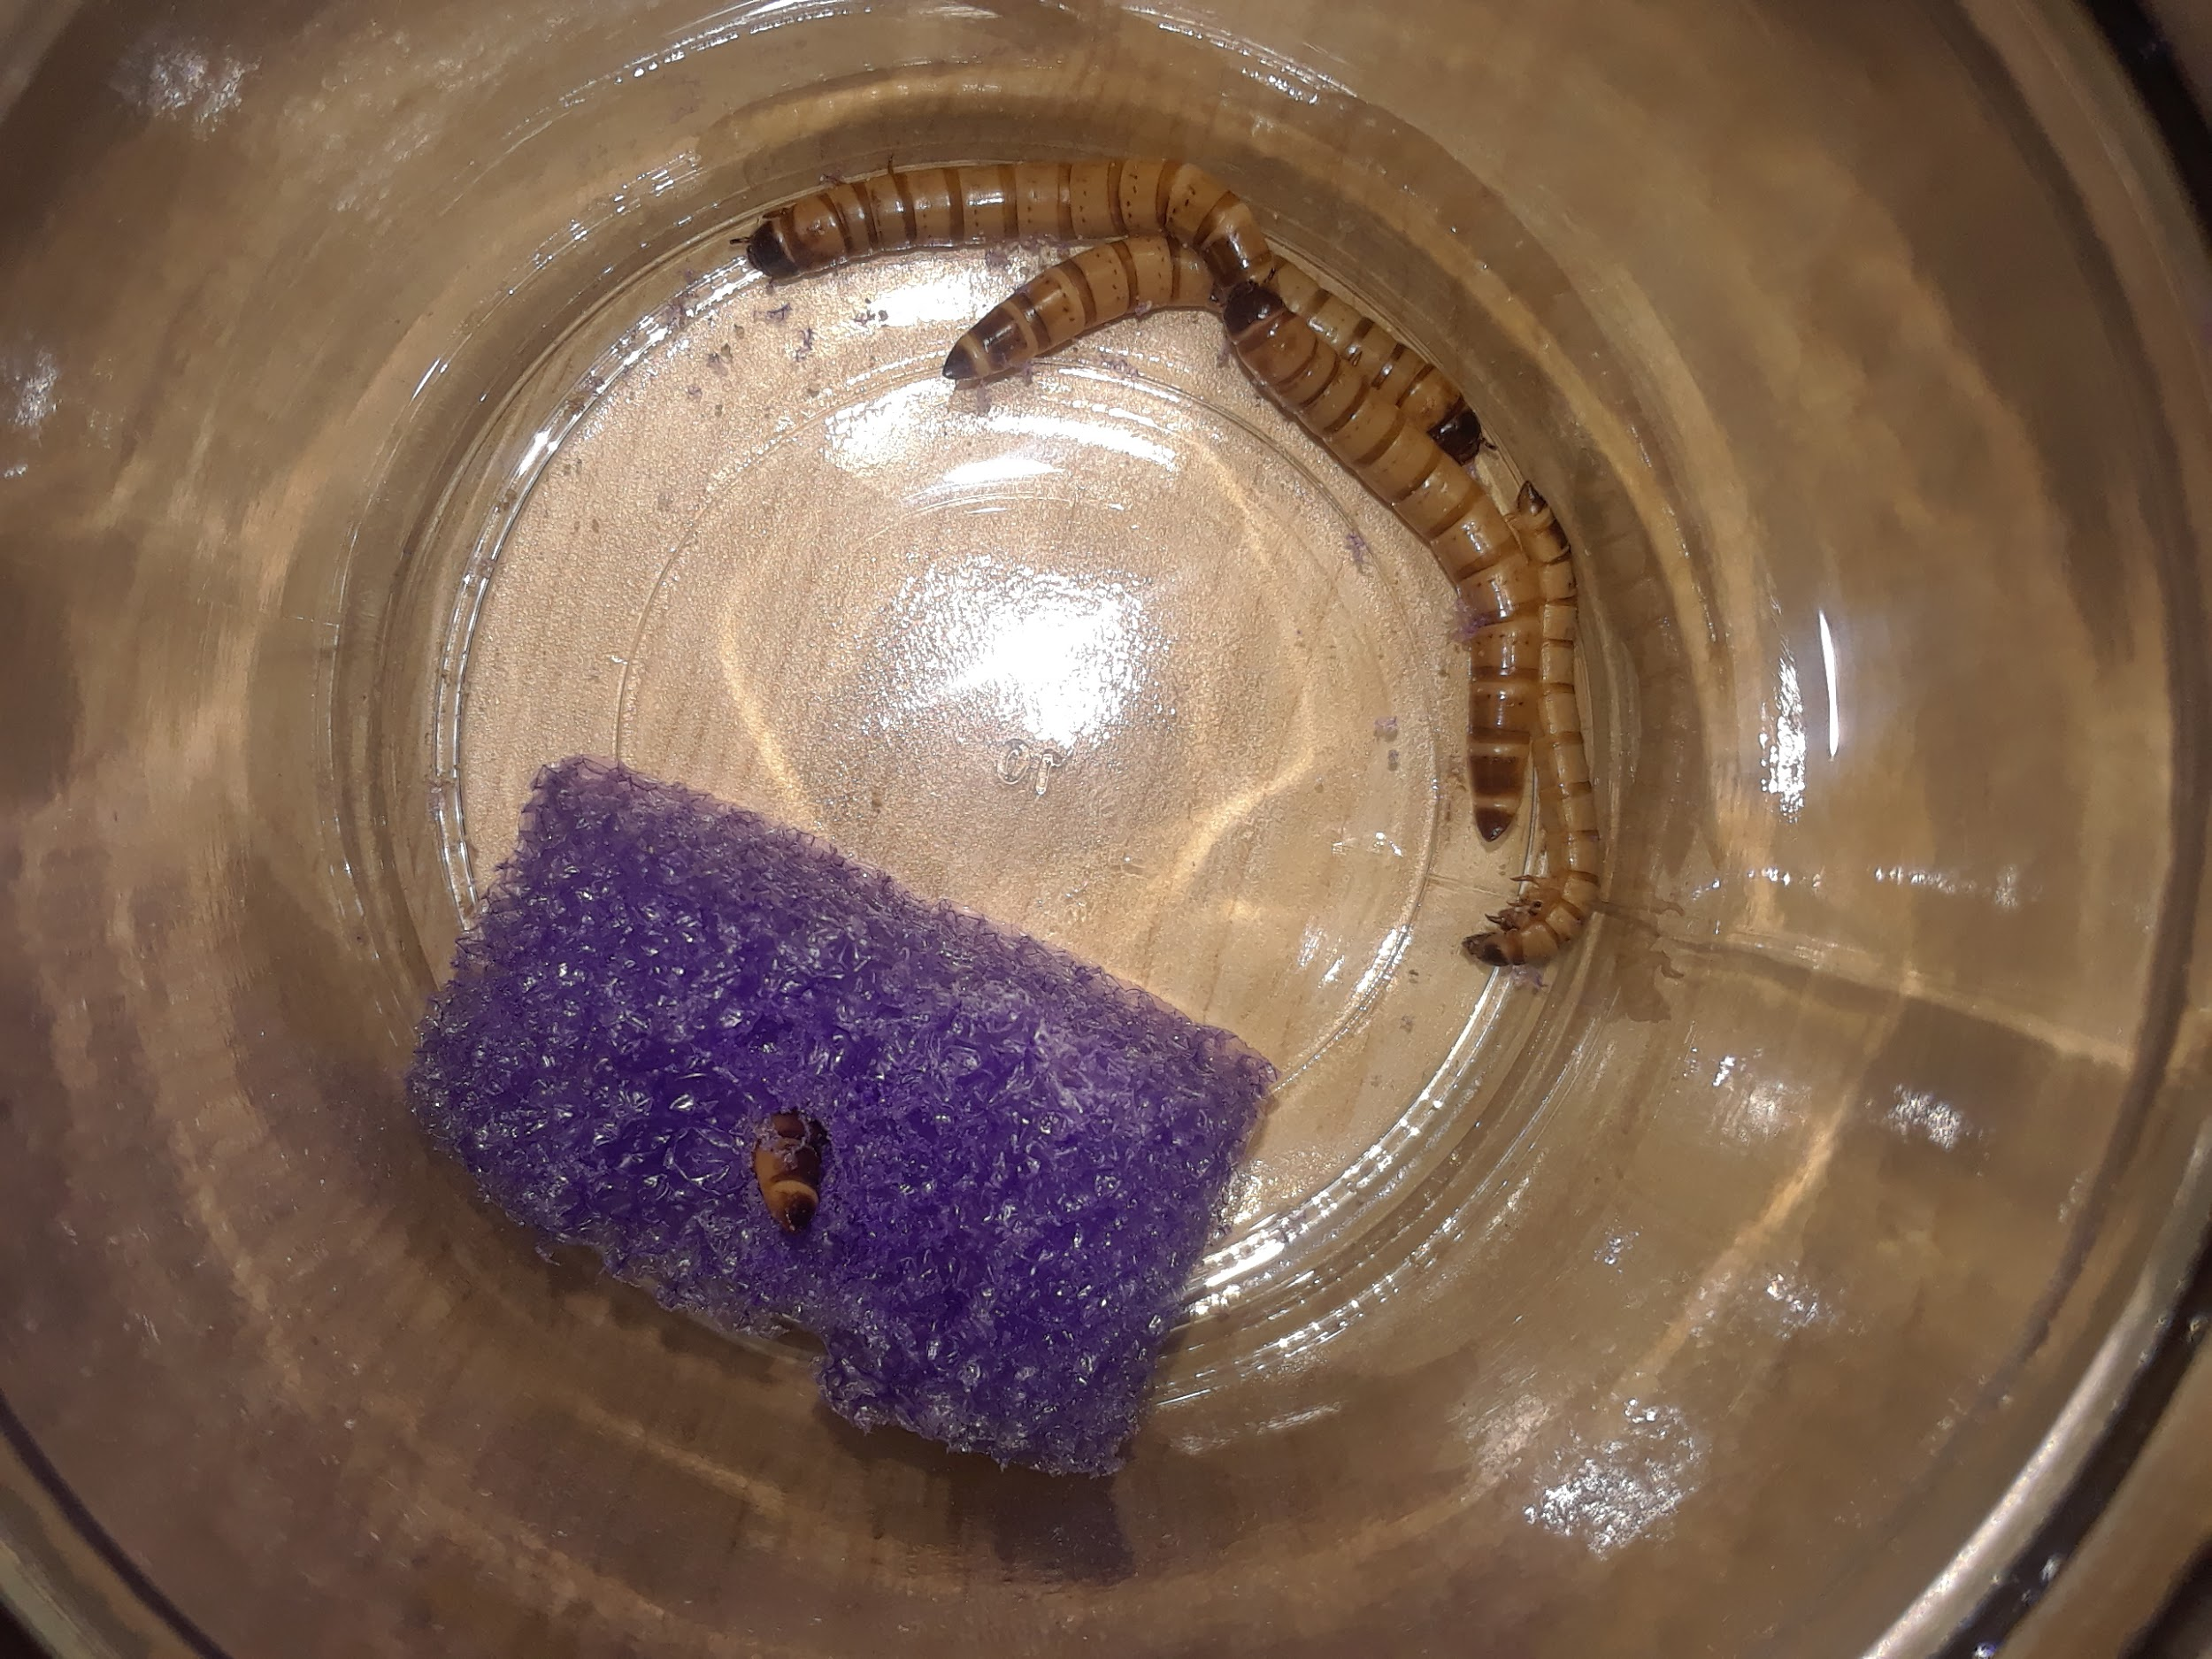

Slide 19
